Slide 1

CAP 6317/4773: Social Media Mining
Lecture 10: Data Mining
Raiyan Abdul Baten, Ph.D.
February 8, 2024

Slide 2
Recap

Slide 3
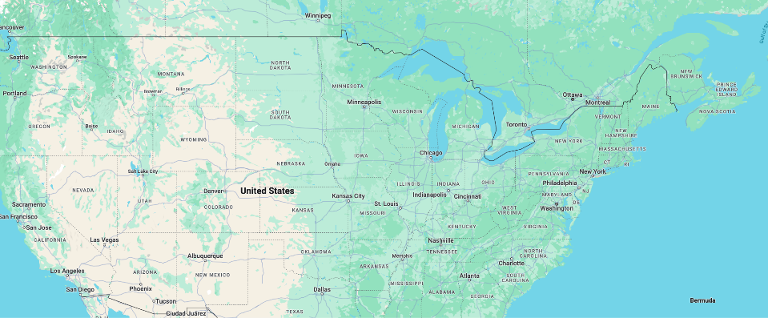
300 packages sent out to people in Nebraska and Boston
You can only forward it to someone you know on a first-name basis
Target: A stockbroker in Boston
100: Live in Boston
100: Stockbrokers
100: Do not live in Boston and are not stockbrokers
Only 64 packets ever made it!
Path length: 5.1

Slide 4
Statistical Characteristics of Networks
Degree Distribution
Clustering Coefficient
Average Path Length
Giant Component

Slide 5
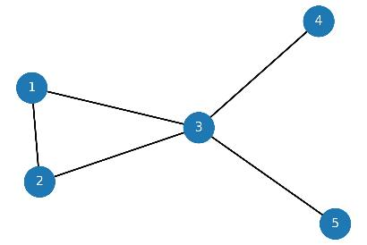
From | To | Shortest paths | Length of the shortest path l_{i,j}
1 | 2 | (1,2) | 1
1 | 3 | (1,3) | 1
1 | 4 | (1,3,4) | 2
1 | 5 | (1,3,5) | 2
2 | 3 | (2,3) | 1
2 | 4 | (2,3,4) | 2
2 | 5 | (2,3,5) | 2
3 | 4 | (3,4) | 1
3 | 5 | (3,5) | 1
4 | 5 | (4,3,5) | 2
Average Path Length
Average of shortest path lengths: 1.5
Diameter
Longest shortest path length: 2

Slide 6
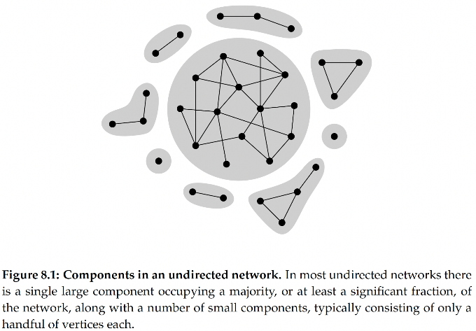
Giant
Component

Slide 7
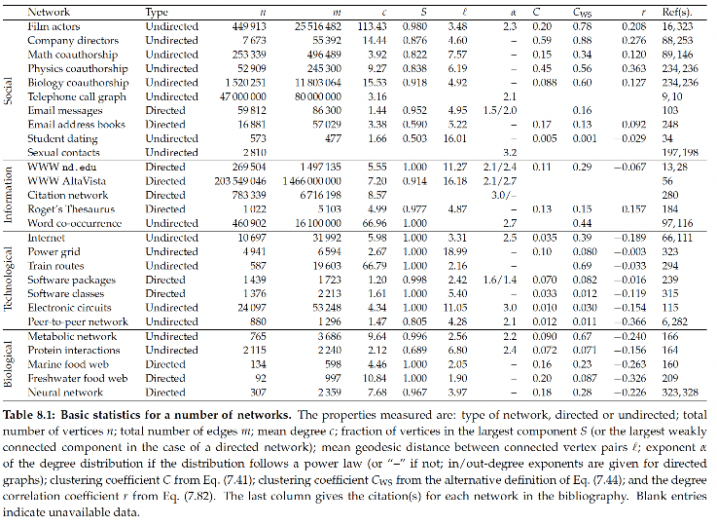

Slide 11
Statistical Characteristics of Real Networks
Degree Distribution
Power Law
Clustering Coefficient
High clustering (global/local)
Average Path Length
Low
Giant Component
Yes

Slide 12
Random Graph Model, G(n,p)
Degree Distribution
Power Law
Clustering Coefficient
High clustering (global/local)
Average Path Length
Low
Giant Component
Yes
…When p is high
But that makes the graph too dense

Slide 13
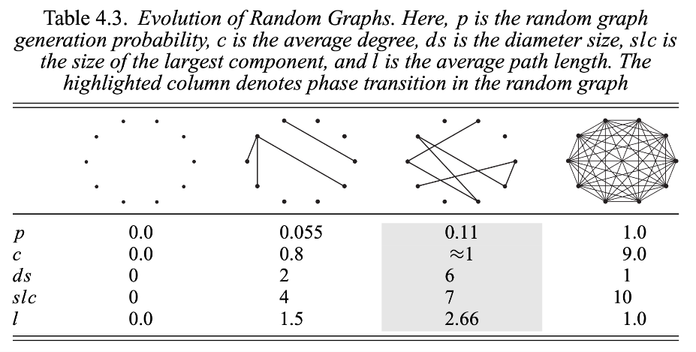

Slide 14
Barabasi-Albert Preferential Attachment Model
Degree Distribution
Power Law
Clustering Coefficient
High clustering (global/local)
Average Path Length
Low
Giant Component
Yes
Triangles rarely get closed!

Slide 15
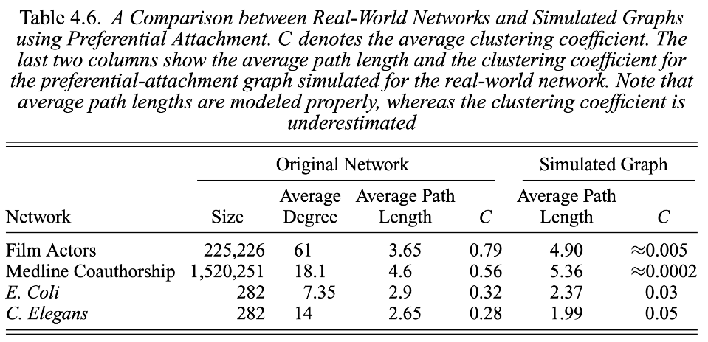

Slide 16
Watts-Strogatz Small World Model
Degree Distribution
Power Law
Clustering Coefficient
High clustering (global/local)
Average Path Length
Low
Giant Component
Yes
Realistic CC and Avg path lengths
Captures the Small World phenomenon!

Slide 17
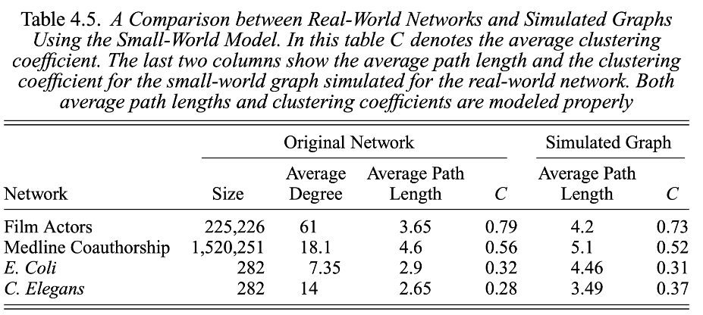

Slide 18
Rewiring probability, p = 0

Slide 19
Rewiring probability, p > 0

Slide 20
Rewiring probability, p > 0

Slide 21
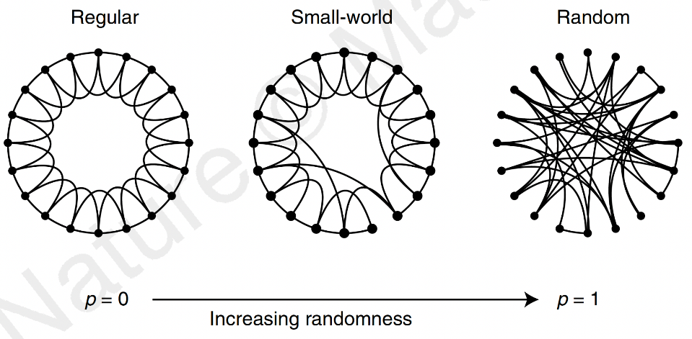

Slide 22
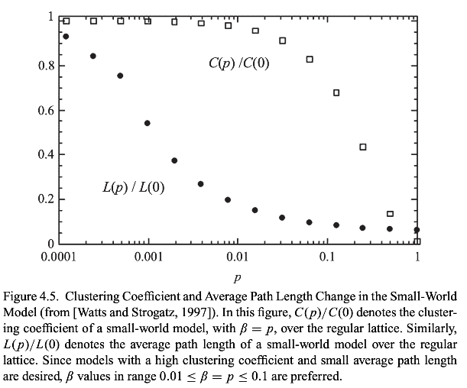

Slide 23
Social Science
Network/computational Science
Let us not forget
Computer science
Machine learning
Ethnography
Mathematics
Optimization
And more!
Social Media Mining
Statistics and Data Mining

Slide 24
Statistics and Data Mining
Statistical Testing
Summarizing the data
Hypothesis testing
Correlation coefficient
Chi Squared test
ML/DL
Supervised learning, Unsupervised learning
Natural Language Processing

Slide 25

Our new smart watch outperforms the old watch by
20%
in terms of sleep tracking accuracy!

Slide 26

So we collect a lot of data
60%
A significant improvement! => 🤑💰💵
Assuming we collected samples correctly and avoided all possible biases in both groups
40%
Sleep Tracking Accuracy
20%
New watch
Old watch

Slide 27
We need a way to summarize our data…
11 users tried the old watch. Against a laboratory-grade sleep tracker, here are the tracking accuracies of this watch:
11, 32, 37, 40, 49, 52, 56, 60, 61, 69, 85

Slide 28
Measuring how ‘spread out’ your data is
11, 32, 37, 40, 49, 52, 56, 60, 61, 69, 85
40, 41, 42, 47, 49, 51, 52, 55, 56, 59, 60
The Arithmetic mean is 50.18 in both cases
The Standard Deviation of the first list is 18.98
The Standard Deviation of the second list is 6.75

Slide 29
Mean and SD together can represent our data
60%
Whiskers denote the SD
40%
Bar height denotes the mean
Sleep Tracking Accuracy
20%
Mean and SD together don’t capture every information about our data, but still gives a reasonable sense of how the data looks like
Old watch

Slide 30
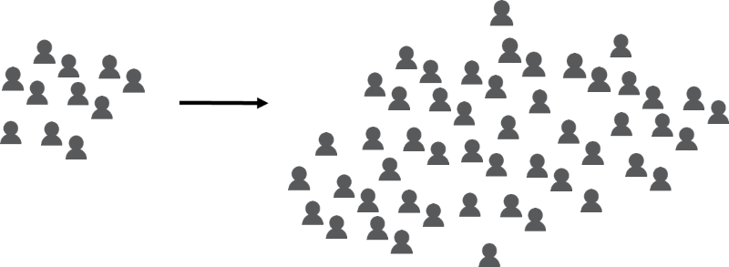
Taking a step back
The Sample
The Population

Slide 31
Introducing the 95% Confidence Interval (C.I.)
60%
Now the whiskers will denote the 95% C.I.
40%
Bar height still denotes the sample mean
Sleep Tracking Accuracy
20%
Intuition
We are 95% confident that the unknown population mean lies within this range around the sample mean
Old watch

Slide 32


Slide 33
Calculating the 95% C.I.
Confidence interval = sample mean ± margin of error
Example
Sample mean = 80
Margin of error = 3.9
Confidence interval = 80 ± 3.9
Lower limit = 80 - 3.9 = 76.1
Upper limit = 80 + 3.9 = 83.9
Reporting style: 95% C.I. = [76.1, 83.9]
83.9
80
76.1

Slide 34

But how do we get the margin of error?
Confidence interval = sample mean ± margin of error
Confidence interval = sample mean ±

Slide 35
Reminder to self: Attendance

Slide 36
Data Mining

Slide 37
We have all the elements in place
Confidence interval = sample mean ± margin of error
Confidence interval = sample mean ±
Note
This formulation won’t work if n is too small (<30). In that case, we will need to use the t-distribution instead of z*, and use n-1 instead of n in the denominator for calculating sample SD.
The python code given in a later slide works even for small values of n. But it is good practice to have as much data (large n) as possible.

Slide 38
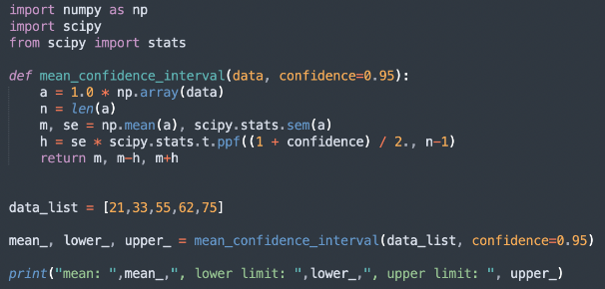
Python implementation: 95% C.I.
Plug in how much confident you want to be. If you wish to be more confident (e.g., 99% C.I.), you will typically need more data for a narrower C.I.
mean: 49.2 , lower limit: 21.990837969061577 , upper limit: 76.40916203093843

Slide 39
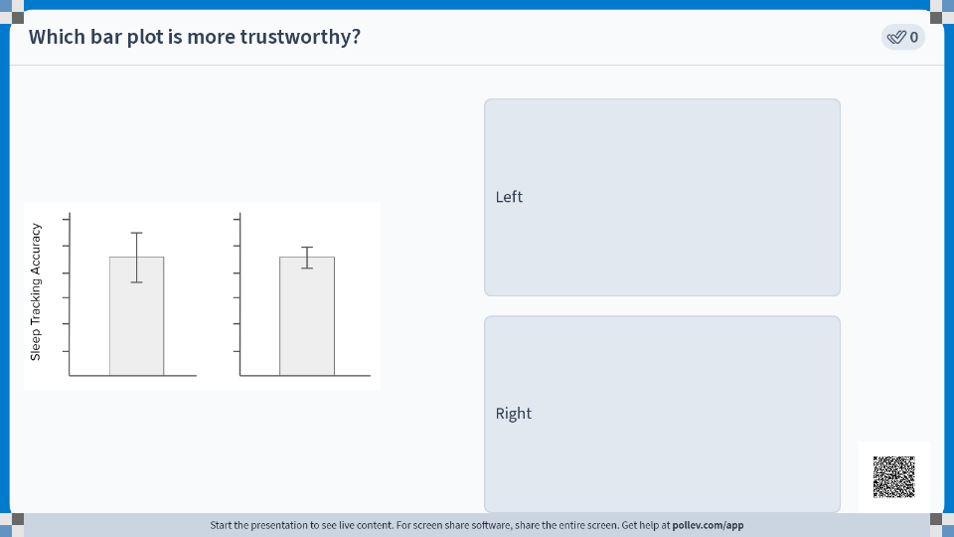

Slide 40
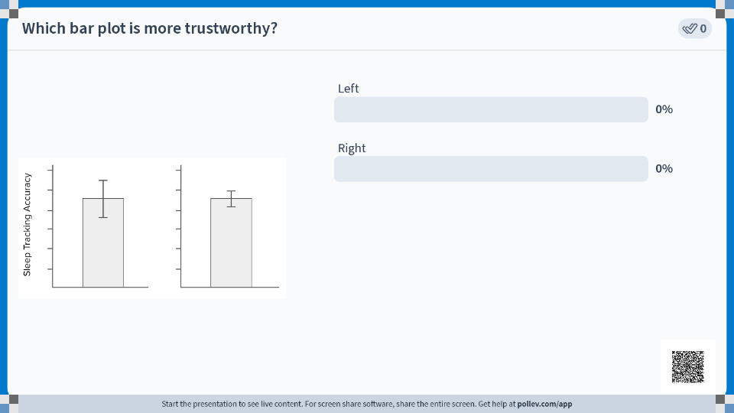

Slide 41
Which bar plot is more trustworthy? Why?
Two teams study the same watch on a separate set of participants. Whiskers denote 95% C.I.
Sleep Tracking Accuracy

Slide 42
Which bar plot is more trustworthy? Why?
Two teams study the same watch on a separate set of participants. Whiskers denote 95% C.I.
Larger n => Narrower margin of error => Narrower C.I.
Narrower C.I. => We have a better sense of the ‘true’ population mean
Sleep Tracking Accuracy
Confidence interval = sample mean ±

Slide 43
Insignificant differences between two groups…

Slide 44

…can become significant with more data.
But not the other way around (assuming the data is collected correctly).

Slide 45
a = [16, 18, 16, 14, 12, 12]
Mean = 14.7
Std = 2.21
95% C.I. = [12.1, 17.2]
a = [16, 18, 16, 14, 12, 12,
16, 18, 16, 14, 12, 12]
Mean = 14.7
Std = 2.21
95% C.I. = [13.2, 16.1]

Slide 46
a = [16, 18, 16, 14, 12, 12]
Mean = 14.7
Std = 2.21
95% C.I. = [12.1, 17.2]
a = [16, 18, 16, 14, 12, 12,
16, 18, 16, 14, 12, 12]
Mean = 14.7
Std = 2.21
95% C.I. = [13.2, 16.1]
Same sample mean, same sample standard deviation. But the confidence interval is narrower since we have more data. We are more confident about the true population mean!

Slide 47
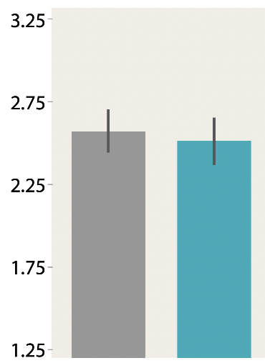
The 95% C.I. bars are overlapping. So, the true population means of the two groups might be the same. The statistical tests will confirm that the two groups are not ‘significantly’ different

Slide 48
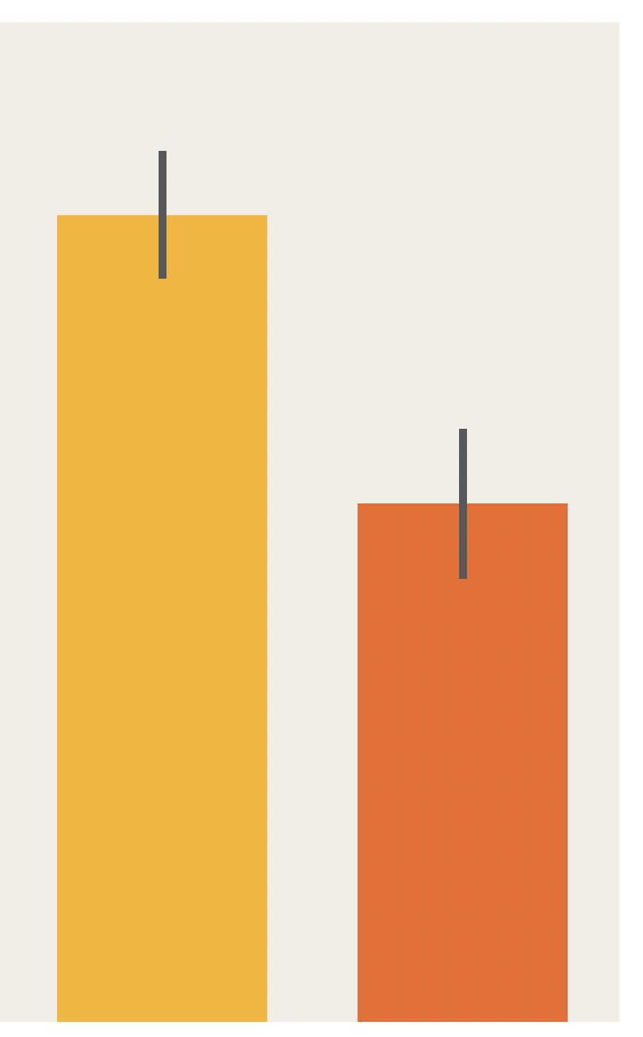
The 95% C.I. bars are not overlapping. So, based on visual eyeballing of the plots, we can hope that the differences between the two groups are significant. We need to run the correct statistical test to confirm it.

Slide 49

Right now the differences seem to be not significant. With more data, the confidence intervals might get narrower, and we might see a significant difference!

Slide 50
Correlation Coefficients

Slide 51
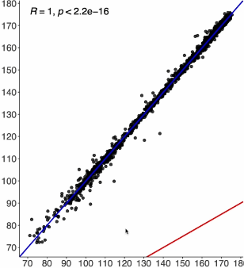
Tracked heart rate by the new watch
True heart rate from chest strap

Slide 52
Perfect correlation: If the true HR increases, the tracked HR also increases
Tracked heart rate by the new watch
True heart rate from chest strap

Slide 53
Perfect correlation: If the true HR increases, the tracked HR also increases
Tracked heart rate by the new watch
Intuition
Correlation checks whether an increase in one variable (x axis) corresponds to an increase in the other variable (y axis).
x goes up, y goes up => positive correlation
x goes up, y doesn’t change => 0 correlation
x goes up, y goes down => negative correlation
True heart rate from chest strap

Slide 54

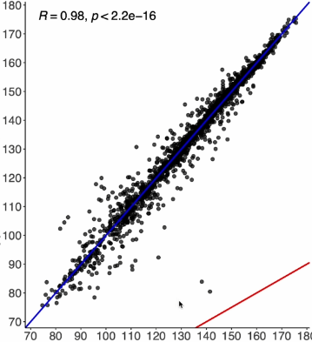
New Watch
Old Watch
r = 0.99
r = 0.97
Tracked heart rate
True heart rate

Slide 55
New Watch
Old Watch
r = 0.99
r = 0.97
Tracked heart rate
Clearly the better watch. There are less ‘errors’ away from the blue line.
Lots of values are away from the perfect blue line. But still, a positive correlation.
True heart rate

Slide 56
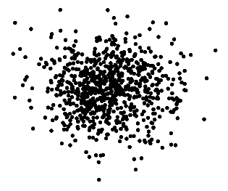
New Watch
Old Watch
r = 0.99
r = 0.97
r = 0.0
Tracked heart rate
Completely random tracking! Correlation = 0
True heart rate

Slide 57
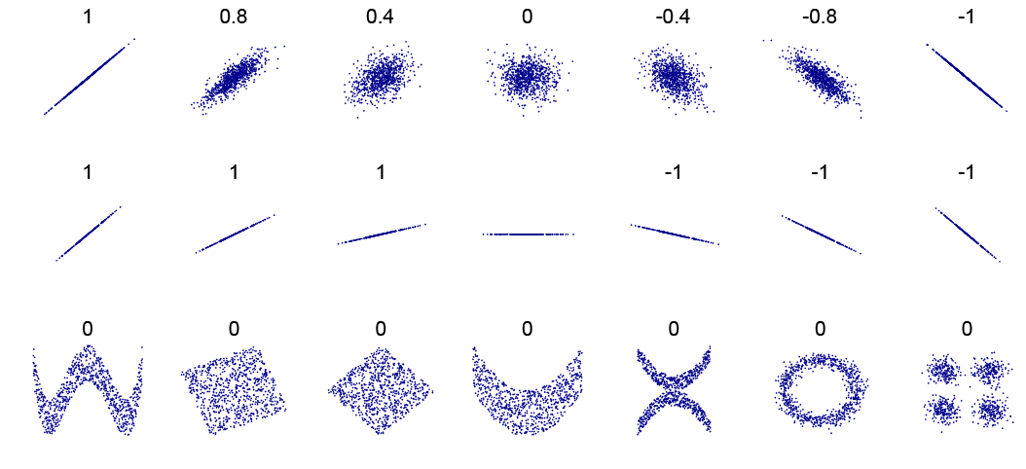
By DenisBoigelot, original uploader was Imagecreator - Own work, original uploader was Imagecreator, CC0, https://commons.wikimedia.org/w/index.php?curid=15165296

Slide 58

Calculating the Correlation Coefficient
A = [44, 21, 25]
B = [99, 65, 79]
µ_{A} = mean of A = 30
µ_{B} = mean of B = 81
σ_{A} = standard deviation of A = 10
σ_{B} = standard deviation of B = 14
n = number of datapoints = 3
Pearson’s

Slide 59
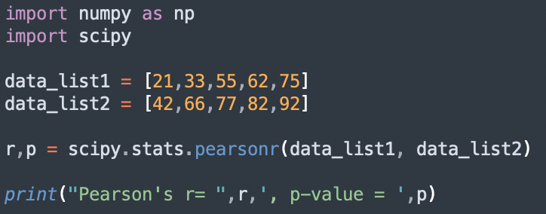
Python implementation: Pearson’s Correlation Coefficient
Pearson's r= 0.9648474398368739 , p-value = 0.007869841382001159

Slide 60


Slide 61
Pearson’s r
Spearman’s ρ
Kendall’s τ
If x increases, does y increase linearly?
Expects a straight line for perfect correlation. For a curve like y=x², the pearson correlation will not be 1.

Slide 62
Pearson’s r
Spearman’s ρ
Kendall’s τ
If x increases, does y increase?
Doesn’t care how much y increases. It suffices to increase.

Slide 63
Pearson’s r
Spearman’s ρ
Kendall’s τ
Similar to Spearman but more robust to outliers

Slide 64
Chi Squared Test

Slide 65
Toss a coin to your Witcher
 | Heads | Tails | Total
Observed frequencies | 4 | 6 | 10

Slide 66
Toss a coin to your Witcher
 | Heads | Tails | Total
Observed frequencies | 4 | 6 | 10
 | Heads | Tails | Total
Observed frequencies | 400 | 600 | 1000

Slide 67
Toss a coin to your Witcher
This can happen due to chance
 | Heads | Tails | Total
Observed frequencies | 4 | 6 | 10
 | Heads | Tails | Total
Observed frequencies | 400 | 600 | 1000
This seems pretty systematic

Slide 68
Saving Grandmas
 | Class started at 9 am | Class started at 11 am | Total
Grandmas died during the semester | 25 | 5 | 30

Slide 69
Office absence patterns seem a bit … odd?
 | Monday | Tuesday | Wednesday | Thursday | Friday | Total
Number of absences | 15 | 12 | 9 | 9 | 15 | 60
Intuition
Chi Square test examines if the observed frequencies are systematically different than our expected frequencies

Slide 70
Chi-Squared test to the rescue!
 | Monday | Tuesday | Wednesday | Thursday | Friday | Total
Number of absences | 15 | 12 | 9 | 9 | 15 | 60
Null hypothesis, H₀: The observed frequencies do not deviate from the expected frequencies
The coin is unbiased / the employees’ absences can be explained by random fluctuations around the expected frequencies
Alternative hypothesis, H_{a}: The data systematically deviates from the expected frequencies–not random!
The coin is biased / the employees’ absences in different weekdays are systematic

Slide 71

Chi-Squared test: Steps
Decide on the ‘expected frequencies’
Can be equally distributed (fair coin) or unequally distributed (slot machine: you are expected to hit the jackpot only rarely)
Calculate the test statistic
Compare the test statistic against the chart
If the test statistic > the value from the table, reject H₀
 | Monday | Tuesday | Wednesday | Thursday | Friday | Total
Number of absences | 15 | 12 | 9 | 9 | 15 | 60

Slide 72
Chi-Squared test: Step 1
Decide on the ‘expected frequencies’
We expect the absences to be uniform throughout the week
 | Monday | Tuesday | Wednesday | Thursday | Friday | Total
Number of absences | 15 | 12 | 9 | 9 | 15 | 60
Expected absences | 12 | 12 | 12 | 12 | 12 | 60

Slide 73
Chi-Squared test: Step 2
Decide on the ‘expected frequencies’
We expect the number of deaths to be similar in different semesters
 | Class started at 9 am | Class started at 11 am | Total
Grandmas died during the semester | 25 | 5 | 30
Expected deaths :( | ? | ? | 30

Slide 74
Chi-Squared test: Step 2
Decide on the ‘expected frequencies’
We expect the number of deaths to be similar in different semesters
 | Class started at 9 am | Class started at 11 am | Total
Grandmas died during the semester | 25 | 5 | 30
Expected deaths :( | 15 | 15 | 30

Slide 75
Chi-Squared test: Step 2
Calculate the test statistic
 | Monday | Tuesday | Wednesday | Thursday | Friday | Total
Number of absences | 15 | 12 | 9 | 9 | 15 | 60
Expected absences | 12 | 12 | 12 | 12 | 12 | 60

Slide 76
Chi-Squared test: Step 3
Compare the test statistic against the chart
We need to know the degree of freedom: df = n-1
There are n=5 columns/workdays. But we know the total number of absences. So (any) 4 of the workdays are truly free to assume any value, but the last workday needs to make sure that all 5 sum up to the total (i.e., we can calculate the 5th day’s absence from the 4 days’ absence data and the total). In other words, n-1 of those days are truly ‘free’, the last one is not. Therefore, df = 5-1 = 4
We need to decide on a significance level: typically α = 0.05 for 95% confidence.

Slide 77
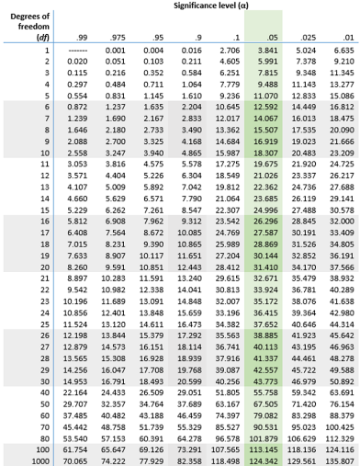
If the test statistic>the value from the table, reject H₀ and accept H_{a} .
Otherwise, we cannot accept H_{a}.
Our test statistic = 3, which is not greater than 9.488
Therefore, we cannot reject H₀
The office absences are due to random chance after all!

Slide 78
Chi-Squared test: Step 1
Decide on the ‘expected frequencies’
We expect the heads and the tails to be evenly distributed
 | Heads | Tails | Total
Observed frequencies | 400 | 600 | 1000
Expected frequencies | ? | ? | 1000

Slide 79
Chi-Squared test: Step 1
Decide on the ‘expected frequencies’
We expect the heads and the tails to be evenly distributed
 | Heads | Tails | Total
Observed frequencies | 400 | 600 | 1000
Expected frequencies | 500 | 500 | 1000

Slide 80
Chi-Squared test: Step 1
Decide on the ‘expected frequencies’
We expect the heads and the tails to be evenly distributed
 | Heads | Tails | Total
Observed frequencies | 400 | 600 | 1000
Expected frequencies | 500 | 500 | 1000
Because a fair coin should have equal number of heads and tails

Slide 81
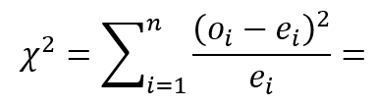
Chi-Squared test: Step 2
Calculate the test statistic
 | Heads | Tails | Total
Observed frequencies | 400 | 600 | 1000
Expected frequencies | 500 | 500 | 1000

Slide 82
Chi-Squared test: Step 2
Calculate the test statistic
(400-500)²/500 + (600-500)²/500 = 40
 | Heads | Tails | Total
Observed frequencies | 400 | 600 | 1000
Expected frequencies | 500 | 500 | 1000

Slide 83
Chi-Squared test: Step 3
Compare the test statistic against the chart
We need to know the degree of freedom: df = n-1
We need to decide on a significance level: typically α = 0.05 for 95% confidence.

Slide 84
Chi-Squared test: Step 3
Compare the test statistic against the chart
We need to know the degree of freedom: df = n-1 = 2-1 = 1
We need to decide on a significance level: typically α = 0.05 for 95% confidence.

Slide 85
Chi-Squared test: Step 3
Making the decision
If the test statistic > the value from the table, reject H₀ and accept H_{a}
Otherwise, we cannot reject H₀

Slide 86
Chi-Squared test: Step 3
Making the decision
If the test statistic > the value from the table, reject H₀ and accept H_{a}
Otherwise, we cannot reject H₀
Here, test statistic 40 > value from the table 3.841
So, we can reject the null hypothesis H₀. In other words, the coin is biased!

Slide 87
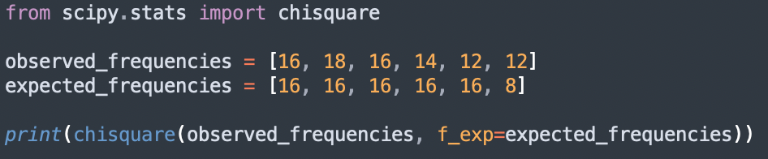
Python implementation: Chi Squared Test
statistic=3.5, p=0.62
p≥0.05, so we cannot reject H₀
In other words, “we do not observe a detectable difference between the observed and expected frequencies”

Slide 88
Hypothesis Testing

Slide 89
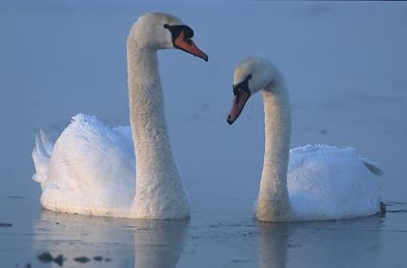
Hypothesis Testing: Intuitions
Potential hypothesis: All swans are white.
(left) By Marek Szczepanek - Own work, CC BY-SA 3.0, https://commons.wikimedia.org/w/index.php?curid=81312.

Slide 90
Hypothesis Testing: Intuitions
In Europe, we can find lots and lots of white swans but no swan of any other color, which might lead to this hypothesis
Potential hypothesis: All swans are white.
(left) By Marek Szczepanek - Own work, CC BY-SA 3.0, https://commons.wikimedia.org/w/index.php?curid=81312.

Slide 91
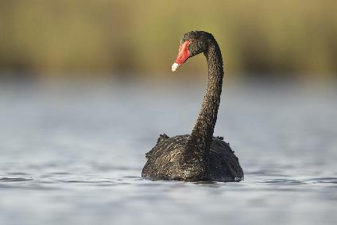
Hypothesis Testing: Intuitions
Potential hypothesis: All swans are white.
Yikes.
(left) By Marek Szczepanek - Own work, CC BY-SA 3.0, https://commons.wikimedia.org/w/index.php?curid=81312. (right) By Marek Szczepanek - Own work, CC BY-SA 3.0, https://commons.wikimedia.org/w/index.php?curid=81312

Slide 92
Hypothesis Testing: Intuitions
Potential hypothesis: All swans are white.
Yikes.
A single future observation of a black swan (e.g., in Australasia) can disprove that hypothesis
(left) By Marek Szczepanek - Own work, CC BY-SA 3.0, https://commons.wikimedia.org/w/index.php?curid=81312. (right) By Marek Szczepanek - Own work, CC BY-SA 3.0, https://commons.wikimedia.org/w/index.php?curid=81312

Slide 93
Skeptical Thinking: The wisdom of Scooby Doo
Hypothesis 1: There are no ghosts
Hypothesis 2: There are ghosts

Slide 94
Skeptical Thinking: The wisdom of Scooby Doo
Hypothesis 1: There are no ghosts
Hypothesis 2: There are ghosts
If we start with this belief, we might keep looking for evidence that supports this belief (similar to finding more white swans), or interpret ambiguous data in favor of ghosts, or ignore contradictory evidence

Slide 95

Skeptical Thinking: The wisdom of Scooby Doo
Hypothesis 1: There are no ghosts
Hypothesis 2: There are ghosts
If instead we start with a skeptical belief that no ghost exists, we can wait for strong evidence before we reject this skeptical belief.
Extraordinary claims require extraordinary evidence!

Slide 96
The Method of Contradiction
Claim: There is life on other planets.
Notes:
Example credit: Research By Design, Youtube content. https://www.youtube.com/watch?v=yLzYy_Rs8C4&ab_channel=ResearchByDesign

Slide 97
The Method of Contradiction
Claim: There is life on other planets.
Can you prove it true?
Can you prove it false?

Slide 98
The Method of Contradiction
Claim: There is life on other planets.
Can you prove it true?
Yes.
Can you prove it false?
We can prove the claim true when we observe a planet that has life

Slide 99
The Method of Contradiction
Claim: There is life on other planets.
Can you prove it true?
Yes.
Can you prove it false?
No.
We can NEVER prove the claim false. We might observe millions of planets that don’t have life (just like finding lots of white swans), sure. But the moment we declare the claim false, someone can find life on the next planet and prove us wrong.

Slide 100
The Method of Contradiction
Claim: There is life on other planets.
Can you prove it true?
Yes.
Can you prove it false?
No.
Claim: There is not life on other planets.
Can you prove it true?
Can you prove it false?
Let us flip the table so that we start with a skeptical belief

Slide 101
The Method of Contradiction
Claim: There is life on other planets.
Can you prove it true?
Yes.
Can you prove it false?
No.
Claim: There is not life on other planets.
Can you prove it true?
Evidence supports
Can you prove it false?
We will still not ‘accept’ this skeptical belief straight away. We will just say “we don’t know” or “things are inconclusive” even when more and more planets keep emerging with no life

Slide 102
The Method of Contradiction
Claim: There is life on other planets.
Can you prove it true?
Yes.
Can you prove it false?
No.
Claim: There is not life on other planets.
Can you prove it true?
Evidence supports
Can you prove it false?
Yes.
The moment we observe a planet with life, we’ll happily “reject” our skeptical position and make a discovery. The key difference between the two claims is that the bottom claim is ‘falsifiable’. And once the claim is proven to be false, we make a discovery.

Slide 103
The Method of Contradiction
Claim: There is life on other planets.
Can you prove it true?
Yes.
Can you prove it false?
No.
Claim: There is not life on other planets.
Can you prove it true?
Evidence supports
Can you prove it false?
Yes.
“Falsifiable”: The Method of Contradiction offers up a statement that can be definitively proven false, and then we use our statistics techniques to attempt to do so. The fact is that statistics can never prove a hypothesis true, but we can sometimes prove one false. Only a falsifiable hypothesis can teach us something definitive.

Slide 104
Does the choice of UI (Light vs Dark mode) affect usage duration?
Skeptical (Null) hypothesis:
Alternative hypothesis:

Slide 105
Does the choice of UI (Light vs Dark mode) affect usage duration?
Skeptical (Null) hypothesis: There is no difference in usage duration
Alternative hypothesis:

Slide 106
Does the choice of UI (Light vs Dark mode) affect usage duration?
Skeptical (Null) hypothesis: There is no difference in usage duration
Alternative hypothesis: There is a difference in usage duration

Slide 107
Does the choice of UI (Light vs Dark mode) affect usage duration?
Skeptical (Null) hypothesis: There is no difference in usage duration
Alternative hypothesis: There is a difference in usage duration
H₀: µ_{D} = µ_{L}
H_{a}: µ_{D} ≠ µ_{L}
µ_{D} and µ_{L} are the mean usage durations of the dark and light mode interfaces

Slide 108
Does the choice of UI (Light vs Dark mode) affect usage duration?
Skeptical (Null) hypothesis: There is no difference in usage duration
Alternative hypothesis: There is a difference in usage duration
H₀ (pronounced “H naught”) is the standard notation to denote the “Null hypothesis”. This is our default or skeptical position. It has to “falsifiable”.
Formally, a Null Hypothesis is a statement that in the general population, no difference exists between samples on a variable
H₀: µ_{D} = µ_{L}
H_{a}: µ_{D} ≠ µ_{L}
µ_{D} and µ_{L} are the mean usage durations of the dark and light mode interfaces

Slide 109
Does the choice of UI (Light vs Dark mode) affect usage duration?
Skeptical (Null) hypothesis: There is no difference in usage duration
Alternative hypothesis: There is a difference in usage duration
H_{a} is the alternative hypothesis. This is the conclusion we make when there is strong evidence to reject the null hypothesis
H₀: µ_{D} = µ_{L}
H_{a}: µ_{D} ≠ µ_{L}
µ_{D} and µ_{L} are the mean usage durations of the dark and light mode interfaces

Slide 110
Does the choice of UI (Light vs Dark mode) affect usage duration?
Skeptical (Null) hypothesis: There is no difference in usage duration
Alternative hypothesis: There is a difference in usage duration
There is no difference in usage duration (according to the null hypothesis), so the usage durations are the same. This is our skeptical position. We need evidence to trust otherwise.
H₀: µ_{D} = µ_{L}
H_{a}: µ_{D} ≠ µ_{L}
µ_{D} and µ_{L} are the mean usage durations of the dark and light mode interfaces

Slide 111
Does the choice of UI (Light vs Dark mode) affect usage duration?
Skeptical (Null) hypothesis: There is no difference in usage duration
Alternative hypothesis: There is a difference in usage duration
30
H₀: µ_{D} = µ_{L}
H_{a}: µ_{D} ≠ µ_{L}
µ_{D} and µ_{L} are the mean usage durations of the dark and light mode interfaces
20
Usage duration (min)
10
Dark mode
Light mode

Slide 112
Does the choice of UI (Light vs Dark mode) affect usage duration?
Skeptical (Null) hypothesis: There is no difference in usage duration
Alternative hypothesis: There is a difference in usage duration
If the difference is significant, reject H₀
30
H₀: µ_{D} = µ_{L}
H_{a}: µ_{D} ≠ µ_{L}
µ_{D} and µ_{L} are the mean usage durations of the dark and light mode interfaces
20
Usage duration (min)
10
Dark mode
Light mode

Slide 113
Does the choice of UI (Light vs Dark mode) affect usage duration?
Skeptical (Null) hypothesis: There is no difference in usage duration
Alternative hypothesis: There is a difference in usage duration
30
H₀: µ_{D} = µ_{L}
H_{a}: µ_{D} ≠ µ_{L}
µ_{D} and µ_{L} are the mean usage durations of the dark and light mode interfaces
20
Usage duration (min)
10
Dark mode
Light mode

Slide 114
Does the choice of UI (Light vs Dark mode) affect usage duration?
Skeptical (Null) hypothesis: There is no difference in usage duration
Alternative hypothesis: There is a difference in usage duration
If the difference is not significant, we have “inconclusive results”
30
H₀: µ_{D} = µ_{L}
H_{a}: µ_{D} ≠ µ_{L}
µ_{D} and µ_{L} are the mean usage durations of the dark and light mode interfaces
20
Usage duration (min)
10
Dark mode
Light mode

Slide 115
Insignificant differences between two groups…

Slide 116
…can become significant with more data.
But not the other way around (assuming the data is collected correctly).

Slide 117
Never, ever “accept” thy null hypothesis!💀

Slide 118


Slide 119
Summary

